Slide 1

Properties of Vehicles That Contribute To CO2 Emissions
Edgar Lopez

Slide 2

Problem Statement
The business problem I wanted to answer was to determine what vehicles or features produced the highest CO2 emissions or had the biggest impact on CO2 emissions. Answering this question will help car manufacturers design cars that are less harmful to the environment, and it will also provide compliance with government environmental regulations.

Slide 3
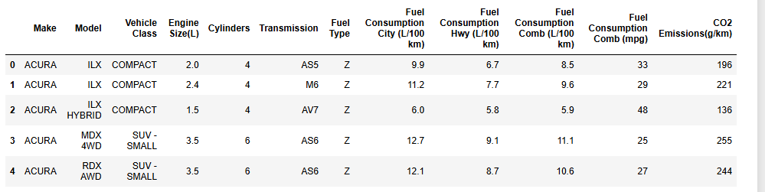
Kaggle Dataset For CO2 Emissions

Slide 4
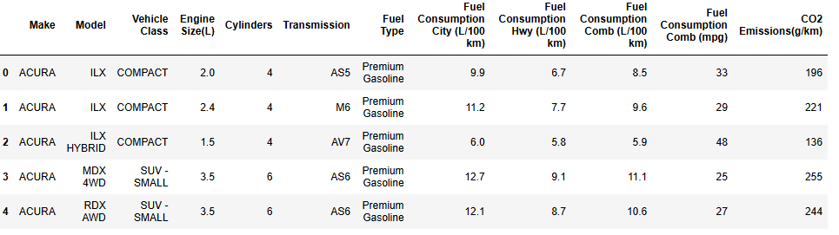
Changed fuel type codes into what the codes represented

Slide 5
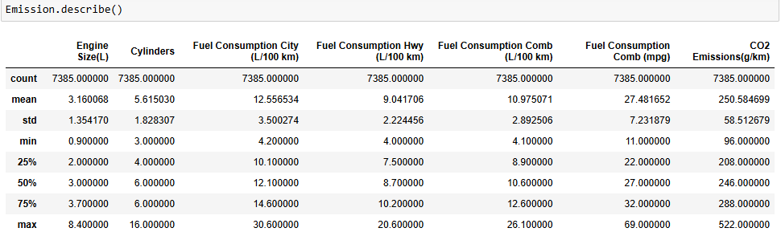
Statistics of Data

Slide 6
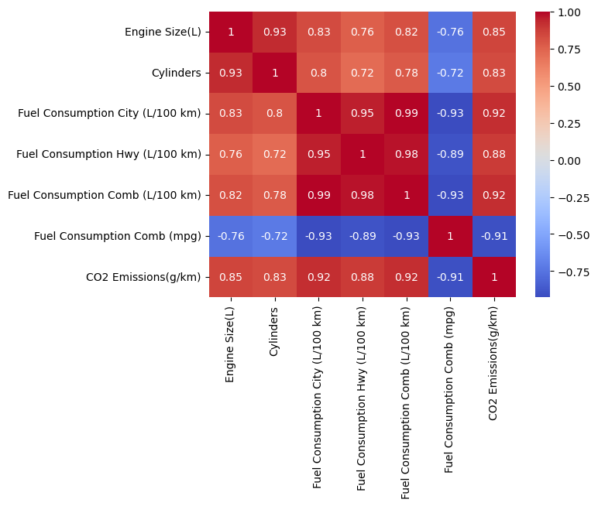
Multicollinearity Detected in Dataset

Slide 7
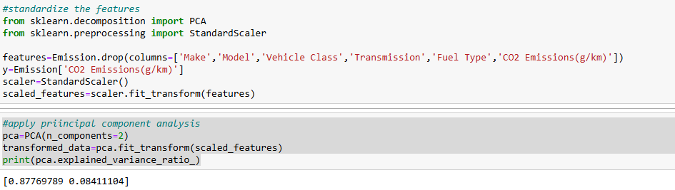
Standardized the Data and Applied Principal Component Analysis

Slide 8
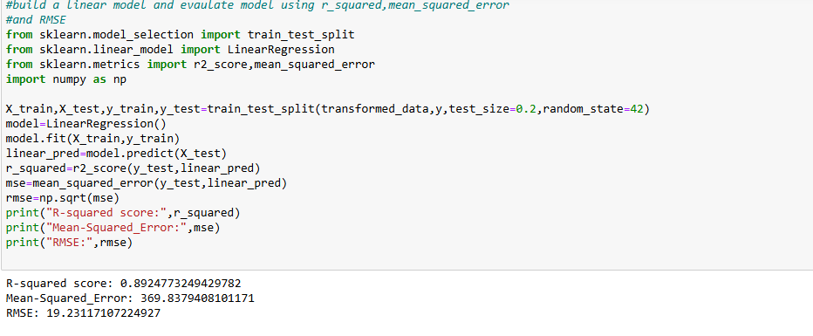
Linear Regression Model
Evaluated model using metrics R-squared score, Mean Squared Error, RMSE

Slide 9
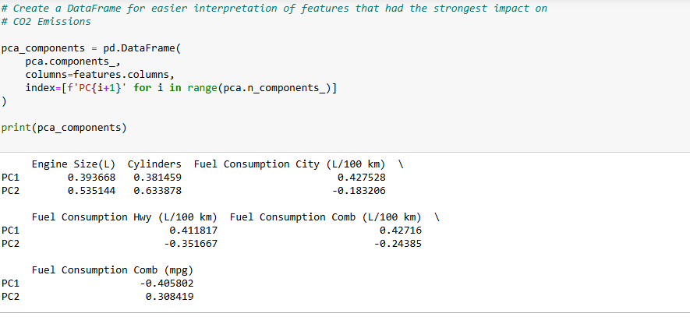
Significant Features for Linear Regression with PCA

Slide 10
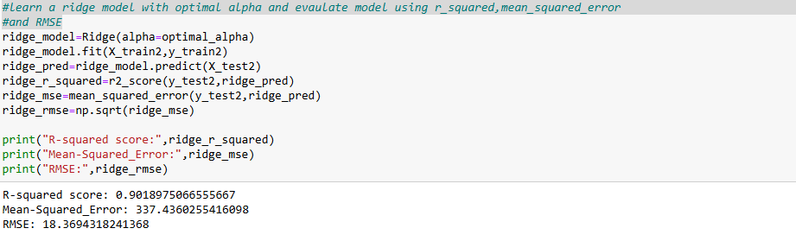
Ridge Regression Model and Evaluation
Evaluated model using metrics R-squared score, Mean Squared Error, RMSE

Slide 11
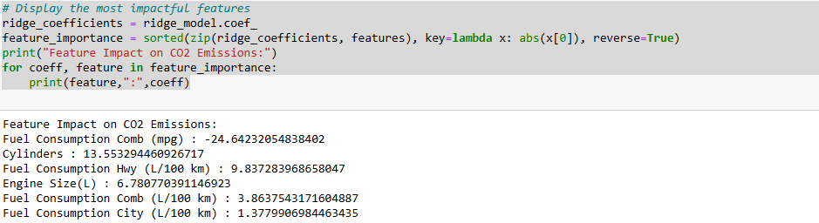
Significant Features for Ridge Regression

Slide 12
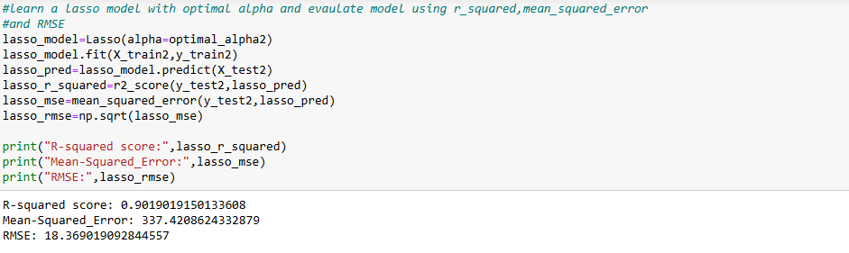
Lasso Regression and Evaluation
Evaluated model using metrics R-squared score, Mean Squared Error, RMSE

Slide 13
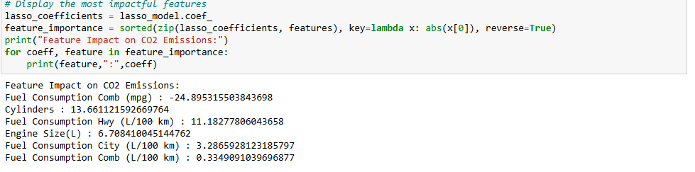
Significant Features for Lasso Regression

Slide 14
Comparison of Models
Metric | Linear Regression with PCA | Ridge Regression with alpha =10 | Lasso Regression with alpha =0.0663
R- squared | 0.895 | 0.9019 | 0.9019
Mean squared error | 369.8379 | 337.4360 | 337.4209
RMSE | 19.2312 | 18.3694 | 18.3690

Slide 15
Significant Features From Models
Feature | Ridge Regression with alpha = 10 | Lasso Regression with alpha = 0.0663
Fuel Consumption Comb (mpg) | -24.6423 | -24.8953
Cylinders | 13.5533 | 13.6611
Fuel Consumption Hwy (L/100 km) | 9.83738 | 11.1828
Engine Size (L) | 6.7808 | 6.7084
Fuel Consumption Comb (L/100 km) | 3.8637 | 0.3349
Fuel Consumption City (L/100 km) | 1.3780 | 3.2866
Feature | PC1 | PC2
Fuel Consumption Comb (mpg) | -0.405802 | 0.308419
Cylinders | 0.381459 | 0.633878
Fuel Consumption Hwy (L/100 km) | 0.411817 | -0.351667
Engine Size (L) | 0.393668 | 0.535144
Fuel Consumption Comb (L/100 km) | 0.427160 | -0.243850
Fuel Consumption City (L/100 km) | 0.427528 | -0.183206

Slide 16
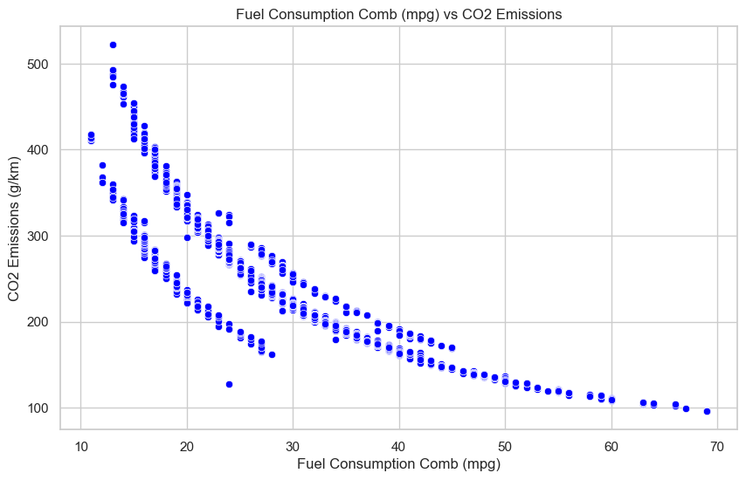
Graph of Fuel Consumption Comb(mpg) vs CO2 Emission
As can be seen from the graph there is an inverse relationship between fuel consumption comb (mpg) and CO2 Emissions

Slide 17
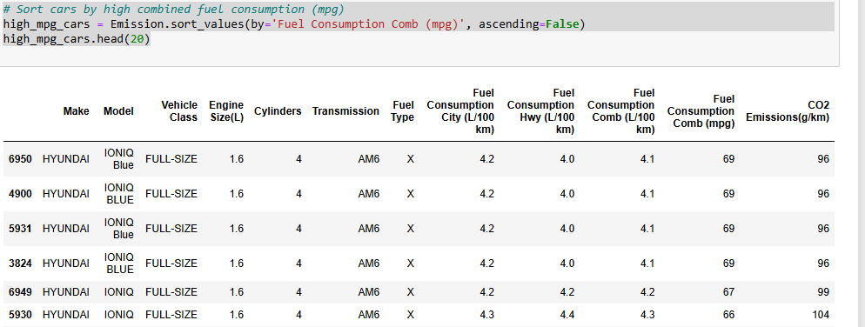
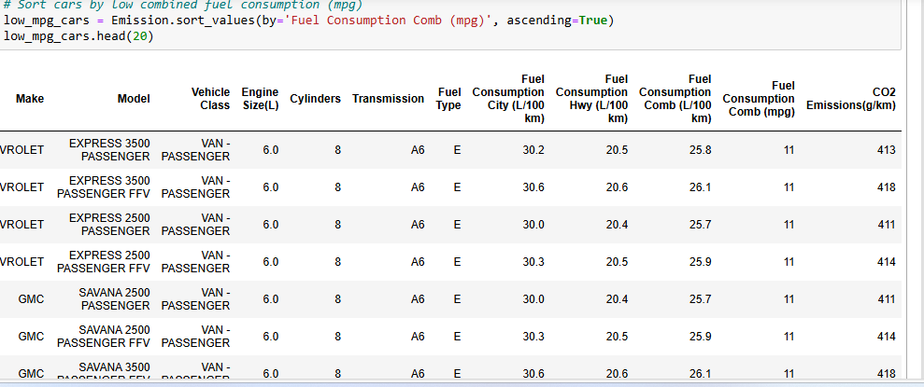
Highest vs Lowest Fuel Consumption Comb (mpg)

